Slide 1

MAST90106
Optimisation of university space based on a supply and demand analysis
A case study on staff meeting rooms and student toilet facilities on campus
Group 3
Abhinav Sharma
Advait Deshpande
Xinyi Xu
Yanming Wang

Slide 2
Problem Description
Related Work
Data Analysis
Summary of Findings
Plans for Next Semester
Structure

Slide 3
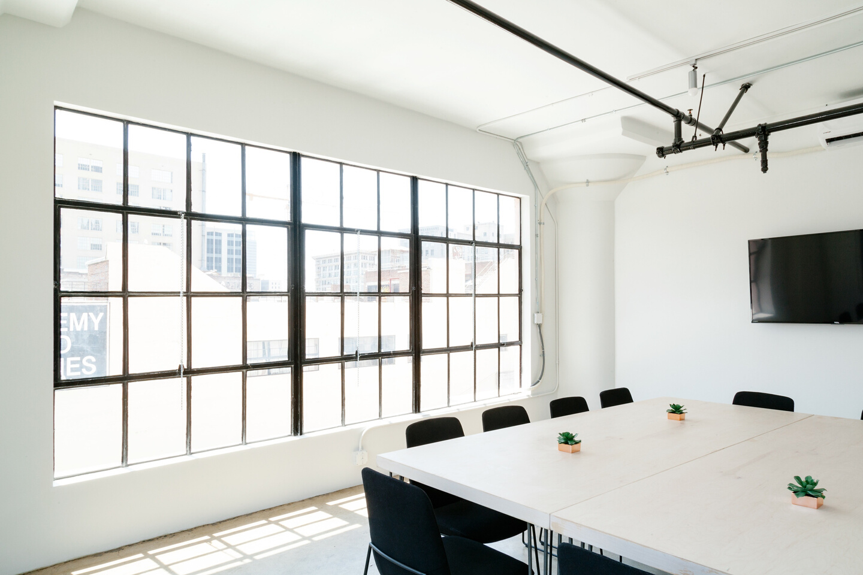
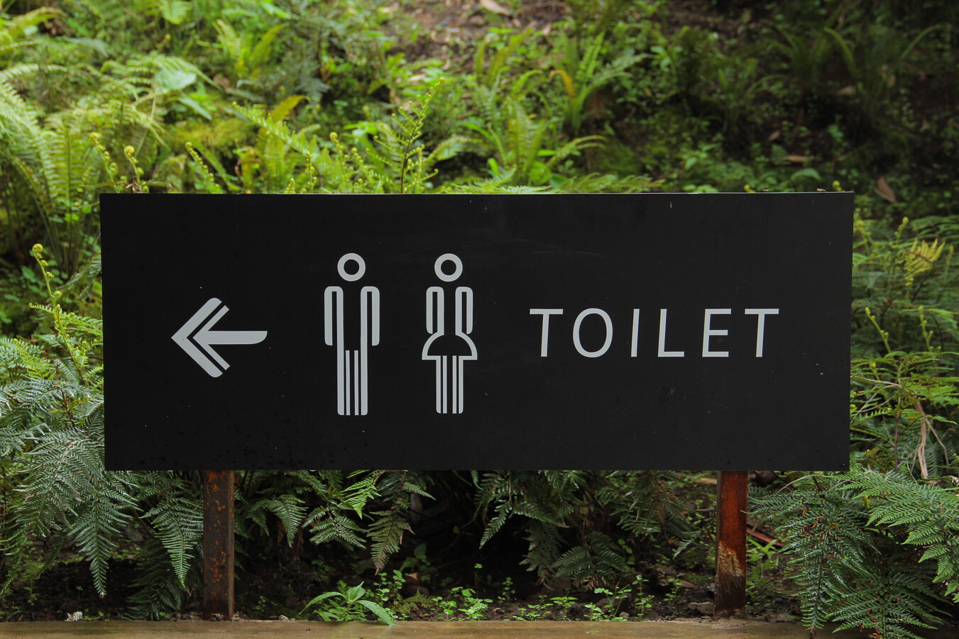
Background
Focus on staff meeting rooms & student toilets
Analyse the current supply and demand
Related Data
Space metadata
Employee location
Timetabling and class registration
Meeting rooms' usage & equipment
Expected Outcome
Detailed analysis report
Models suggesting nearest toilets and meeting rooms
Interactive dashboard

Slide 4

Extensive exploratory data analysis of supply and demand
Complicated data mutations, joins and preprocessing
Correlations analysis
Spatial data analysis using QGIS 3
Predictive modelling on well-defined constraints
How Data Science?

Slide 5

Constraint
Goal
Related Work
Students’ activities are limited by their selected subjects, staff are usually based in a single location, and other than the physical distance, the actual utilization of meeting rooms and toilets should also be considered.
Our goal is taking all of those variables into consideration and see how the arrangement and maintenance services can be optimised given current supply and demand.

Slide 6
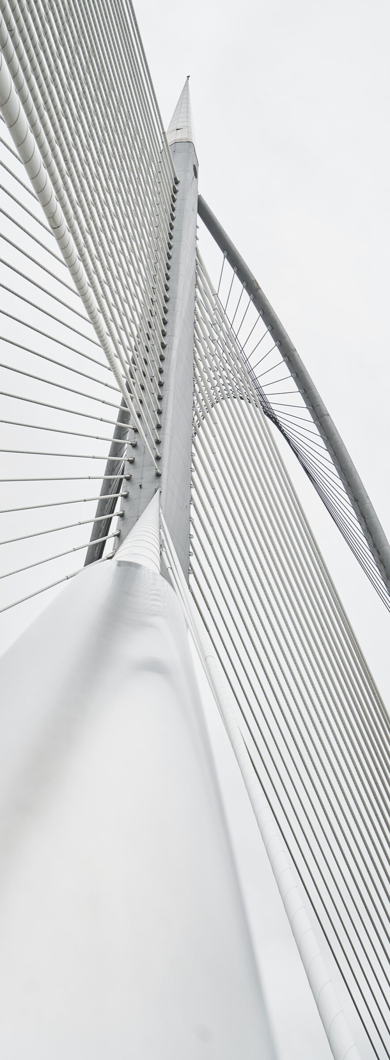
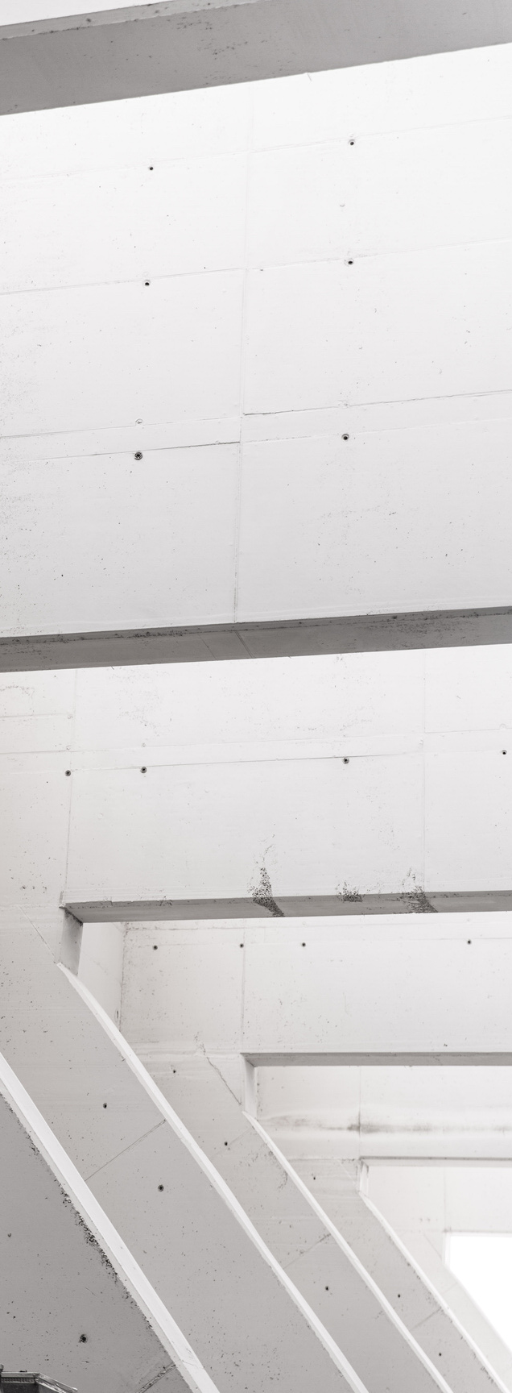
Greedy Heuristics
The greedy algorithm is designed through a cost function that taking all constraints violated into accounts. However, this algorithm cannot guarantee to reach a global optimal solution. Furthermore, this algorithm is not considering room optimization as it’s constraints

Slide 7



Three stages iterative algorithm
Initialization stage
Second
stage
Final
stage
Greedy algorithm to find a roughly feasible solution.
Simulated annealing method to find a local optimal solution.
Random perturbations to improve the result.

Slide 8

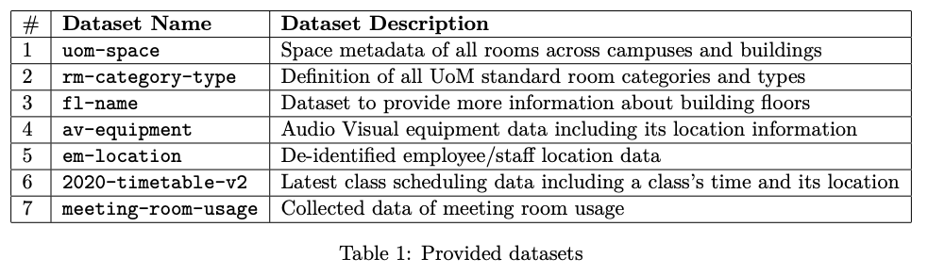
Exploratory Data Analysis

Slide 9
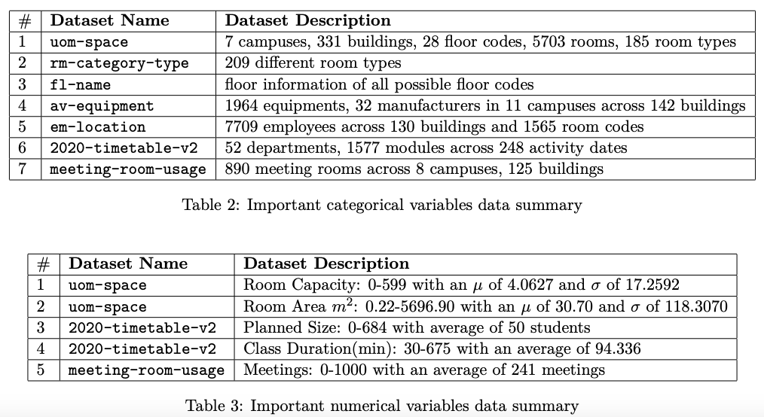
Exploratory Data Analysis

Slide 10
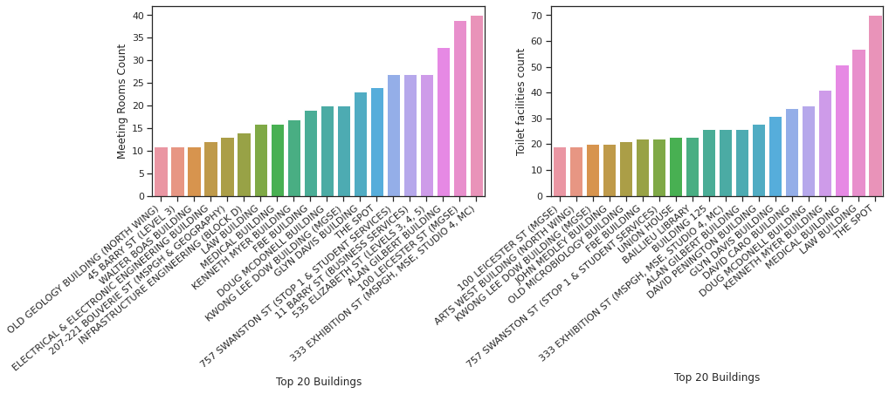
Exploratory Data Analysis
333 Exhibition st building has the highest number of meeting rooms
The spot building has the highest number of toilet facilities

Slide 11
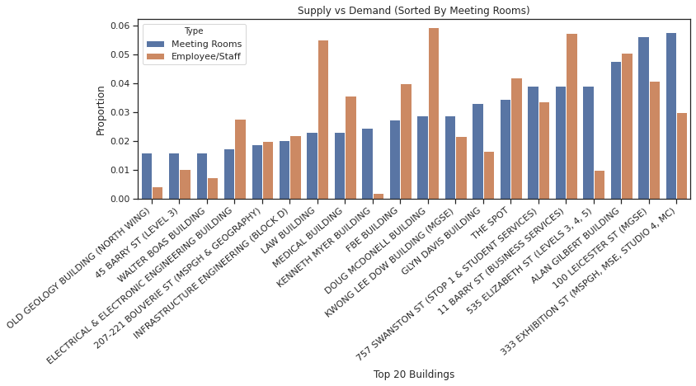
Exploratory Data Analysis
Law Building: Demand of Meeting rooms >> Supply
Kenneth Myer Building: Supply of Meeting rooms >>> Demand

Slide 12
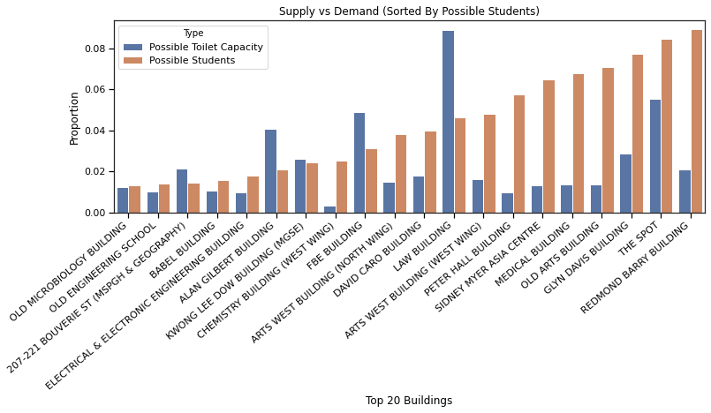
Exploratory Data Analysis
Redmond Barry Building: Demand of Toilet Facility >>> Supply
Law Building: Supply of Toilet Facility >> Demand

Slide 13

Data Preprocessing
Importance of Preprocessing.
Methods used in preprocessing.

Slide 14
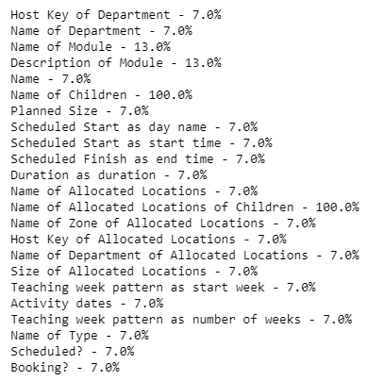
Data Preprocessing
Pre-processing is one of the most important task before data modelling.
Cleaning and correct data types form the crux of the preprocessing.
Few operations: lower casing, date format, removing white spaces,etc
Data provided is not in correct format nor the data valid.
Number of columns have invalid data. Removing these values and replacing them with a constant, improves the quality as these can be omitted while data modelling.

Slide 15
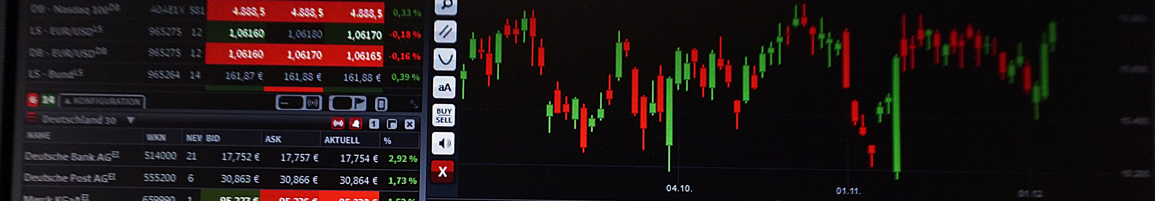
Data Correlations
Meeting Rooms
Toilet Facilities
Analysis of preferences and factors for staff booking a meeting room
Analysis of preferences and factors for student using a toilet facility

Slide 16
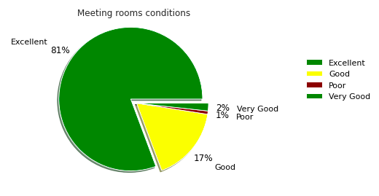
Data Correlations
Preferences and factors for a booking a meeting room
Same building
Same floor
Meeting room with equipments
Same department
Good/Excellent Room Condition
Easily available meeting room

Slide 17
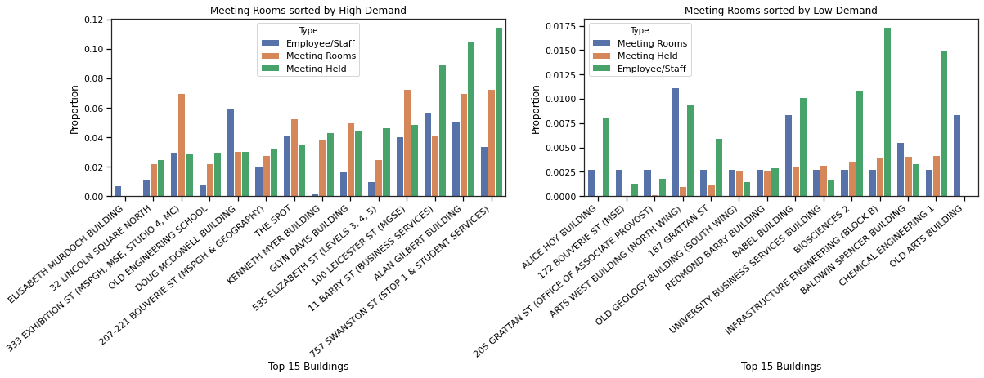
Data Correlations
Meeting rooms Availability Correlation
Stop 1: Extremely high demand, very less supply = Less chance of getting a meeting room
Old Arts Building: Very low demand, good supply = High chance of getting a meeting room

Slide 18
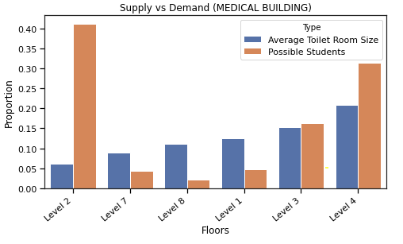
Data Correlations
Preferences and factors for using a toilet facility
Same building
Same floor
Good/Excellent facility condition
Room size of the facility
Class durations

Slide 19
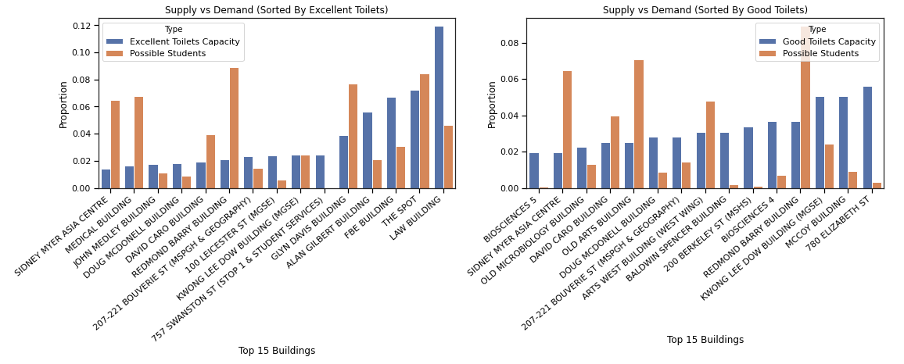
Data Correlations
Toilet Facilities Conditions Correlation
Law Building: Highest number of toilet capacity in excellent condition
Redmond Barry Building: Around 3% toilet capacity in good condition and 2% in excellent condition

Slide 20
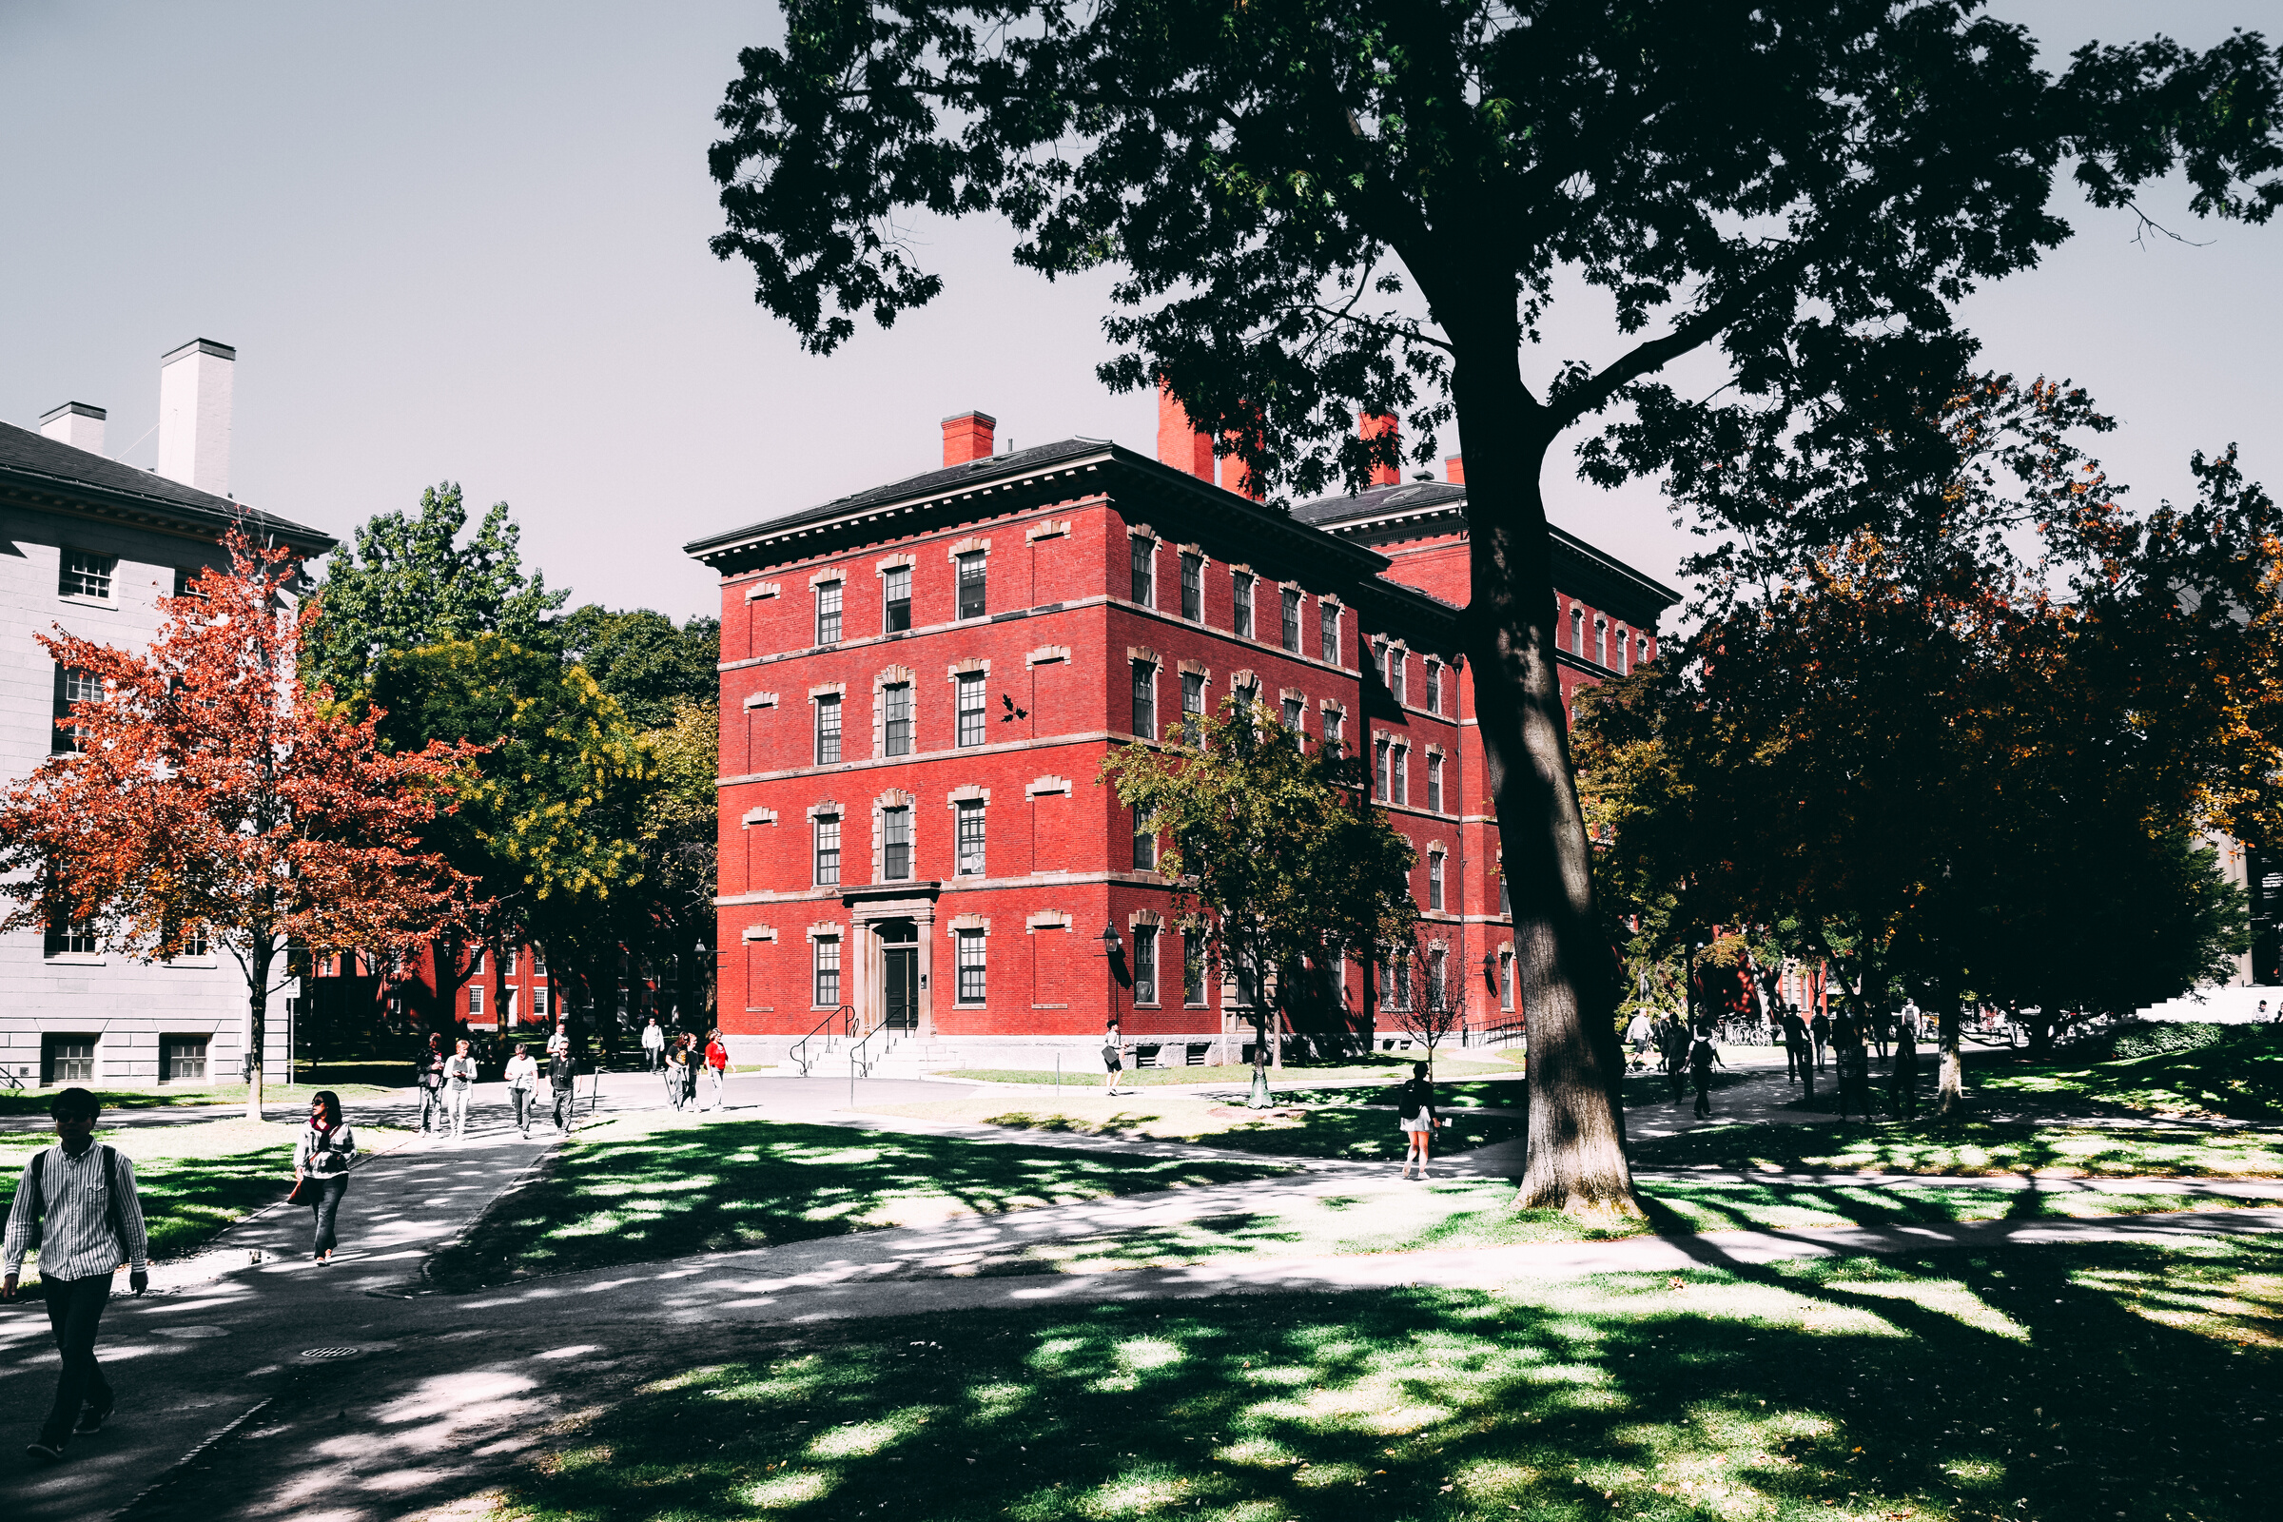
Spatial Analysis
Use QGIS
If the current allocation for meeting rooms can offer flexibility for staffs?
Map staffs and meeting rooms data with geolocations of Parkville's building

Slide 21
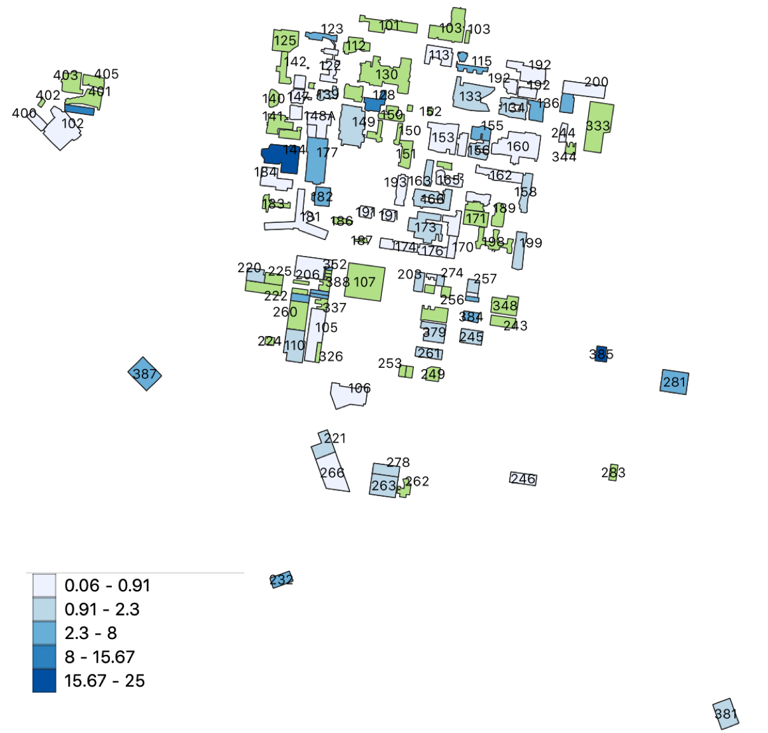
Spatial Analysis
For each building, Average Meeting Room Capacity per Staff = Capacity of Meeting Rooms/Number of Staffs
3-minute walk (around 240 meters) is the distance people are willing to walk
Dark (blue) cell represents high availability
Green colour indicates that either the meeting room or staff number is zero

Slide 22
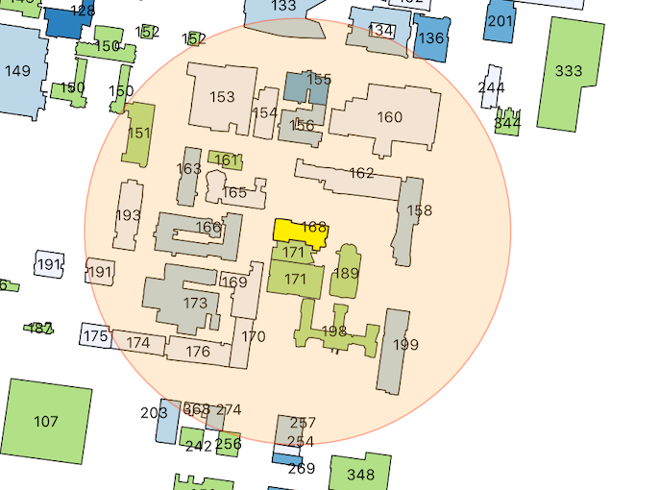
Spatial Analysis
Doug McDonell Building
Located in the main campus
More alternative choices
e.g. Old Engineering School (173) , Walter Boas (163) and Old Geology building(155)

Slide 23
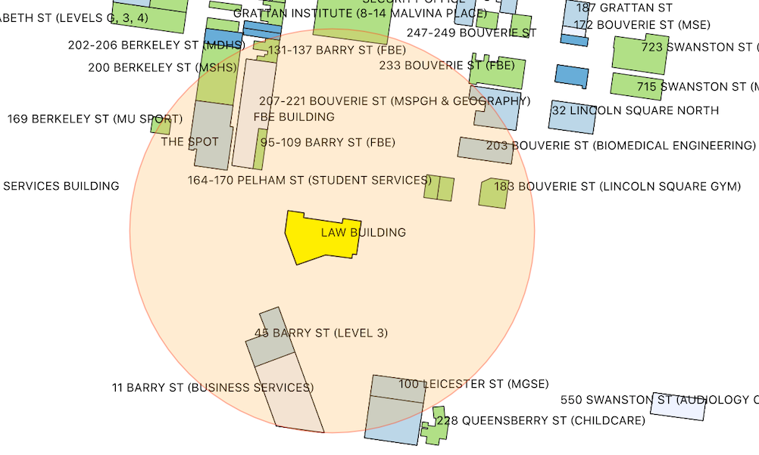
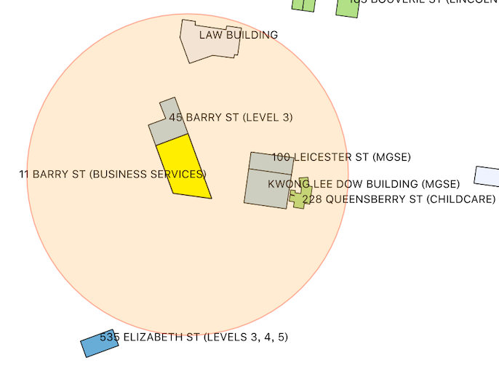
Spatial Analysis
Law Building & 11 Barry Street
Small number of nearby buildings
Surrounding buildings have low ratio

Slide 24

Proposed Methods
Spatial Algorithm
Floor Algorithm
Finding the most optimal nearest building
Finding the most optimal nearest floor for a building
Objective: Propose a solution that can efficiently use the current supply of the resources

Slide 25
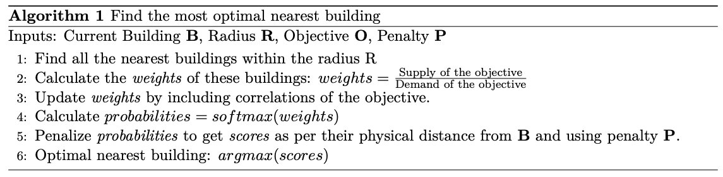
Proposed Methods
Method 1: Finding the most optimal nearest building
Based on Greedy heuristics: Finds roughly feasible solution
Higher weights = better supply of the objective
Correlations weights adjustment will play an important role

Slide 26
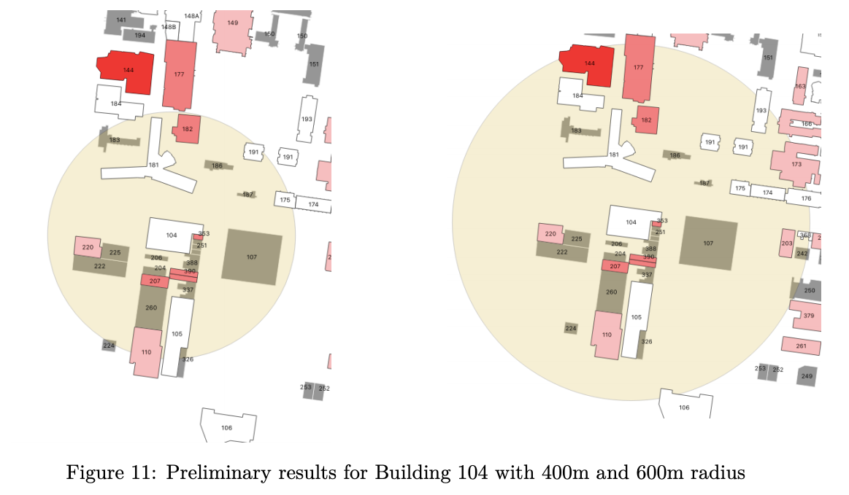
Proposed Methods
Most optimal nearest building from Alan Gilbert (104) for booking a meeting room:
MDHS Building (207): 400m radius
Kenneth Myer Building (144): 600m radius
Method 1: Finding the most optimal nearest building

Slide 27
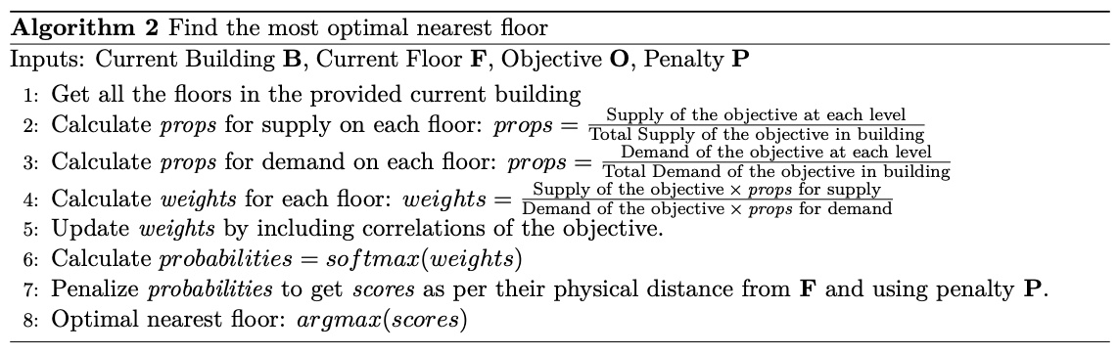
Proposed Methods
Method 2: Finding the most optimal nearest floor for a building
Based on Greedy heuristics: Finds roughly feasible solution
Higher weights = better supply of the objective
Correlations weights adjustment will play an important role

Slide 28
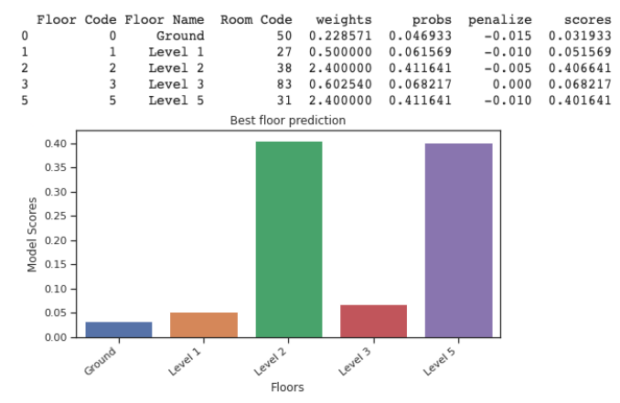
Proposed Methods
Most optimal nearest floor from Level 3 in Kwong Lee Dow (263) for booking a meeting room:
Level 2: First preference
Level 5: Second preference
Ground: Worst choice
Method 2: Finding the most optimal nearest floor for a building

Slide 29
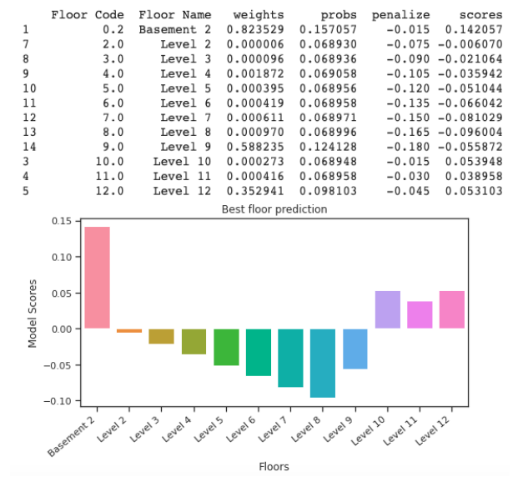
Proposed Methods
Most optimal nearest floor from Level 1 in Redmond Barry (115) for using a toilet facility:
Basement 2: First preference
Level 10: Second preference
Level 8: Worst choice
Method 2: Finding the most optimal nearest floor for a building

Slide 30

Timeline Part-2
Week 1-6
Week 7-12
Method proposals Enhancements + Better Predictions Modelling
Detailed Analysis Report + presenting important findings

Slide 31
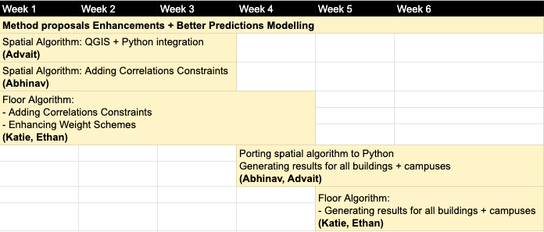
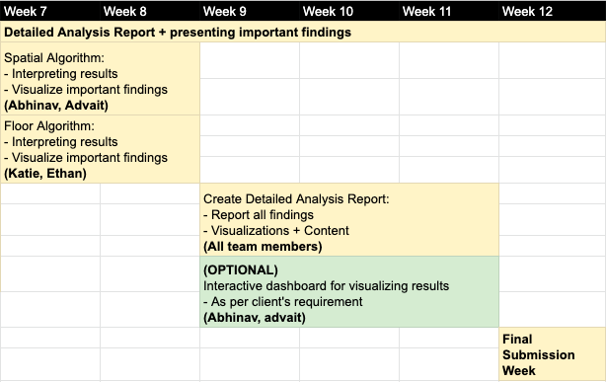
Timeline Part-2
Week 1-6
Method proposals Enhancements + Better Predictions Modelling
Week 7-12
Detailed Analysis Report + presenting important findings

Slide 32
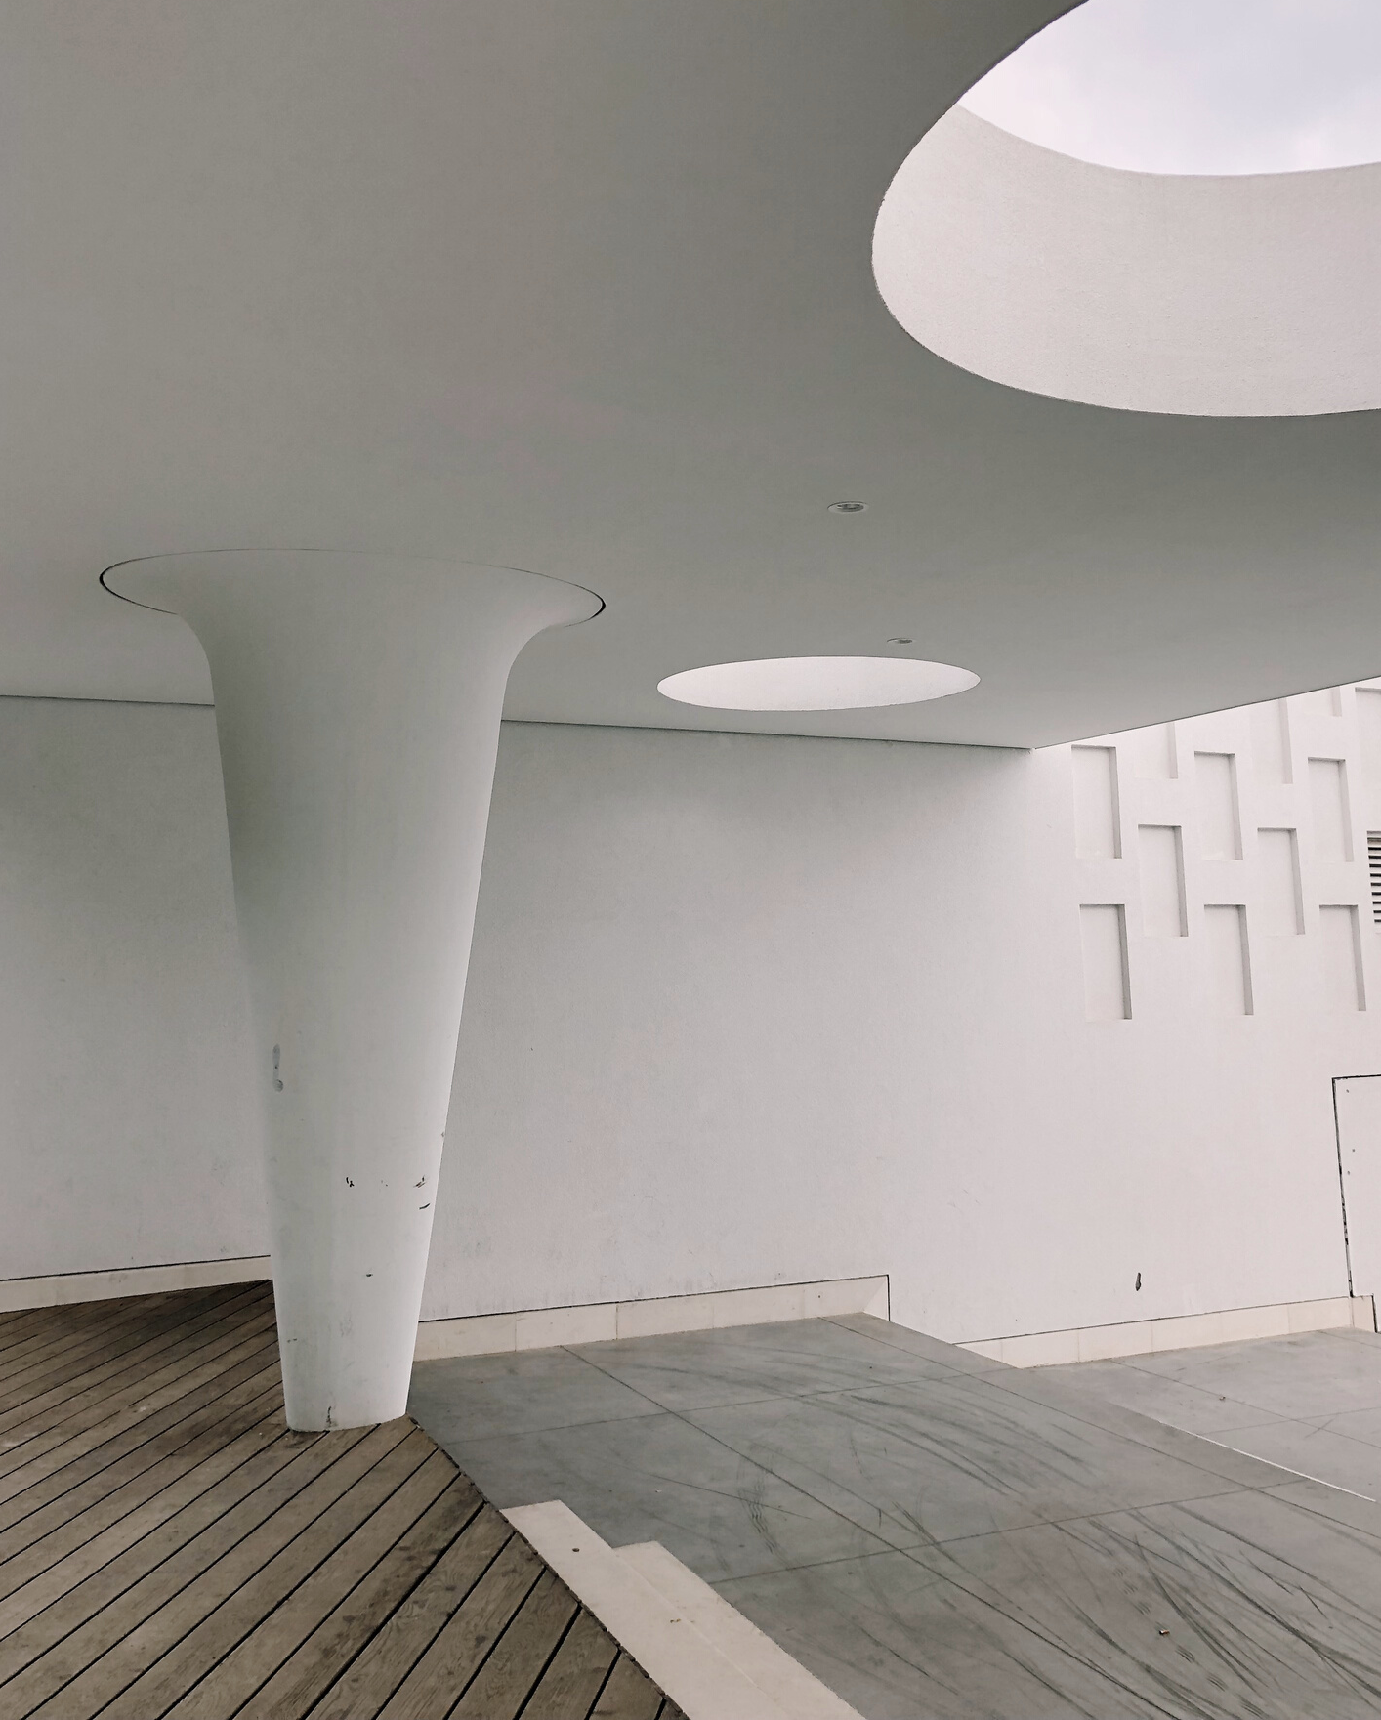
Thank You

